Slide 1
The Journey from Shame to Forgiveness
Marcio Guzman, PhD, LMHC & Katie Andrews-Guzman, M.Ed, LMHC

Slide 2
What to expect from our talk?
(Agenda)
1. Why are we here?
2. Getting into the “What” (the theory of why we are here) - the nitty gritty/the “facts.” What are shame, forgiveness, etc…
3. Getting into the “How” (the practice) Getting into your life. HOW do we take what we know and turn it into some kind of actionable PRACTICE that will help us move away from shame?
4. Talking about Internal Family Systems Therapy (aka IFS. Our personal favorite therapeutic modality and perspective of human beings, which complements our understanding of ACA work (esp the wise parent/inner child).

Slide 3
Pre-presentation thoughts
1. Our process in writing this - How can we talk about shame and forgiveness in 90m? There are books upon books upon experts upon experts on these topics! There are many commonalities among the human experience of moving from shame to forgiveness, but each person’s experience is unique and each situation is unique. The ideas we will share today are ones originally disseminated by some of our favorite researchers and thinkers in our field. Some ideas are our own as a result of our personal and professional experiences.
2. Ultimately, the point will be connection. We develop shame as a result of loss of connection in key moments, and we experience healing and the opportunity to develop forgiveness in moments of connection with our true self and others. The human connection is central to healing - both self-to-self and self-to-other. This is one reason why ACA is healing. It also offers a framework to peel back the layers of shame and pain so you can move towards authenticity, healing, and connection. ACA offers community and scaffolding for healing to take place.
3. We are aware that we are speaking to a group of diverse people. You come from a variety of backgrounds and have a variety of different identities, some of which we can relate to and some we cannot. Some of you may know everything we are sharing today, and some who are hearing these ideas for the first time.

Slide 5
“Addiction (including problematic repeating relationship patterns) is not the primary problem, it is an attempt to solve a problem…how did the problem arise?”

Slide 6
The what
“…its one thing to recognize that all of this originates in childhood pain…” (ie. the theory)

Slide 7
What is shame?
Coming to terms with our current struggles does involve understanding “what happened” (ie. how attachment relationships/developmental trauma leads to our present day issues). But our present day issues aren’t solved by our insights about the past. Insight helps us view ourselves and others with more compassion and understanding, which is wonderful but not curative. What’s MOST important is learning: “how does my past still persist in my present day life…and what kinds of therapeutic experiences actually help me feel more and more free from them…what kinds of experiences help me move away from emotional pain and relationship and behavior patterns that ultimately hurt me and others and towards the person I hope to become?” Almost always, SHAME and FEAR are the core burdensome feelings at the root of everything. They are the crux/the core/the source of most of the problematic extreme issues we experience in our life (eg. everything on “the laundry list”). This is true both for internally located problems (i.e. those very real but generally untrue perceptions we all suffer from, which we experience as a result of shame/fear) and externally located problems (i.e. our behavior, which manifests as a result of the perceptions that shame/fear create inside of us).
Shame, by definition, is the belief “I am bad.” But a definition doesn’t define how it feels, which is more important for identifying it. It’s not that we consciously experience the thought “I’m bad.” It’s that we experience an unbearably painful subjective feeling of wanting to hide some part of us. It’s the unendurable experience that comes when we feel exposed in some way. It is the most painful of the emotions that humans can experience. Shame is often an invisible experience for this very reason, when our shame is triggered, we often immediately react to it with some “secondary” feeling/behavior, like anger, anxiety, depression, perfectionism/people pleasing, grandiosity, or addictive behavior/pattern. Shame is a feeling that lingers in the shadows. We often don’t experience it because that “secondary” reaction comes in so hot and fast.
Fear and shame come together (ie. often we are anxious about something, not because we fear that thing, but because we expect that thing will leave us with a feeling of shame. Often when we are depressed, it’s not because we are truly stuck, it’s because we deeply feel that all of our available choices will leave us feeling shame. Often when we are angry about something, it’s not because that very thing is so objectively angering, it’s because at a more core level, we feel there is something wrong with us that we are having to deal with that thing…and so on and so forth)

Slide 8
What is forgiveness?
“a conscious, deliberate decision to release feelings of resentment or vengeance toward a person or group who has harmed you, regardless of whether they actually deserve your forgiveness.” (https://greatergood.berkeley.edu/topic/forgiveness/definition)
What forgiveness is not:
1. Moving on quickly without giving yourself a reasonable opportunity to feel the feelings associated with the hurt (eg. sadness, anger, confusion, helplessness, positive feelings you believe you shouldn’t feel, etc…Ie. saying “it is what it is…”)
2. An obligation to reconcile or invite another person or group back into your life
3. It’s not for another person. It’s for you. It’s not something that can only be offered to those who deserve it.
4. Condoning or excusing
5. Denying or glossing over the seriousness of an event
6. Feeling positive feelings towards the offensive actions (yours or another).
7. Its not linear
8. Its not something you can force
9. Something that you do alone
(https://greatergood.berkeley.edu/article/item/what_is_forgiveness)
Self-forgiveness and forgiveness of others are both important. Forgiveness is very similar to acceptance. It is a place you get closer and closer to as you feel your way through the things you normally don’t want to accept about yourself and your life experience. We think it feels more like the absence of tension and pain than the addition of something. It feels more like peace and noticing that you’ve let go.

Slide 9
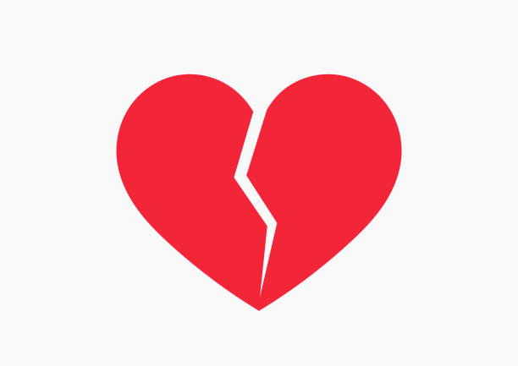
What is the process of moving from shame to forgiveness?
What do we call feeling the feelings that arise as we seek to accept something we currently deem unacceptable?….GRIEF!
GRIEF (feeling all the feels, protesting/resisting/denying/distracting…
and then getting back to feeling the feels.
Two steps forward, one step back, etc.)
FORGIVENESS
SHAME
Caption

Slide 10
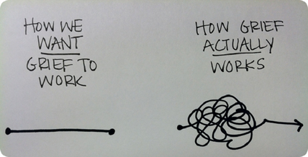
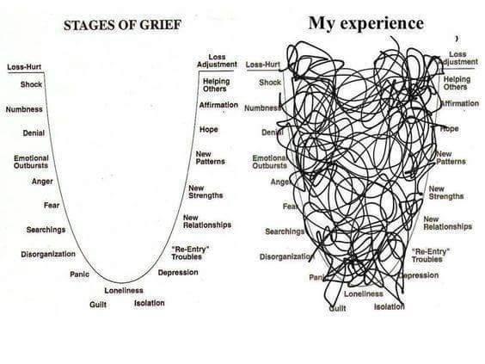
What is grief?
Coping with loss. The origin of developmental trauma is a loss/disconnection from our authentic self due to needing to change Ourself to maintain survival needs (attachment). Grieving this loss is about eventually reclaiming/recovering yourself.
Caption
Caption

Slide 11
The how
“…it is one thing to recognize that all of this originates in childhood pain…
its quite another thing to transform the pain…” (ie. the practices)

Slide 12
Practice being in the present moment
Do you have trouble with downtime?
Starting simple: even learning to remember to practice counts!
Learning to pause.
Leaning to be in the present moment.
Learning to witness your inner experience.
Learning to be present even as you are uncomfortable. Frustration tolerance.
** You can’t intervene with your inner experience if you can’t first bear witness to it without reacting.
** Barrier to practice: “I’m not good at it” & believing it should be relaxing

Slide 13
Practice Self-Compassion
“Hey, be your own best friend!”
“okay, that would be nice”
(What we’re usually thinking in the beginning: “…groan! This is lame toxic positivity! It seems so fake and superficial. I’d have to pretend, I don’t believe it…”)
We need a good enough why to get us over this hump. It isn’t effective to take a look at our pain or our shadow unless we have one foot in love and compassionate understanding. It is never healing or therapeutic to witness your pain through the lens of self-hatred, regardless of whether that self-loathing is obvious (ie “I hate myself) or less obvious (ie “As I am aware of this pain, I just want it to go away” ie. “I may be telling myself that I am approaching this part of me with compassion, but really I just want to heal it the f*#$ out of me!!”)
While it seems counterintuitive (or even seemingly impossible to those beginning to do this work) to accept pain or to approach it without any agenda at all, it is ultimately a very effective way. Think about how you feel when someone “trying to help” you seems to be in a rush for you to stop feeling so grumpy, angry, or emotional? On the surface they seem to be accepting, but you can feel they really just want you to stop feeling. In this scenario, you don’t actually get to feel and release your emotions - you end up truncating your emotional process and suppressing those “bad” feelings. They get stuck inside.
Intervening with “I’m FINE” - we are almost always having some kind of emotional experience. The goal isn’t to constantly feel our feelings because we need to learn to compartmentalize, but when our pattern has been to truncate our emotional processing, we need to practice feeling regularly.
I’m FINE = “feelings inside not expressed.” Or the more colorful “fucked up, insecure, neurotic, emotional.” Either way, I’m FINE is a form of denial and self-protection.

Slide 14
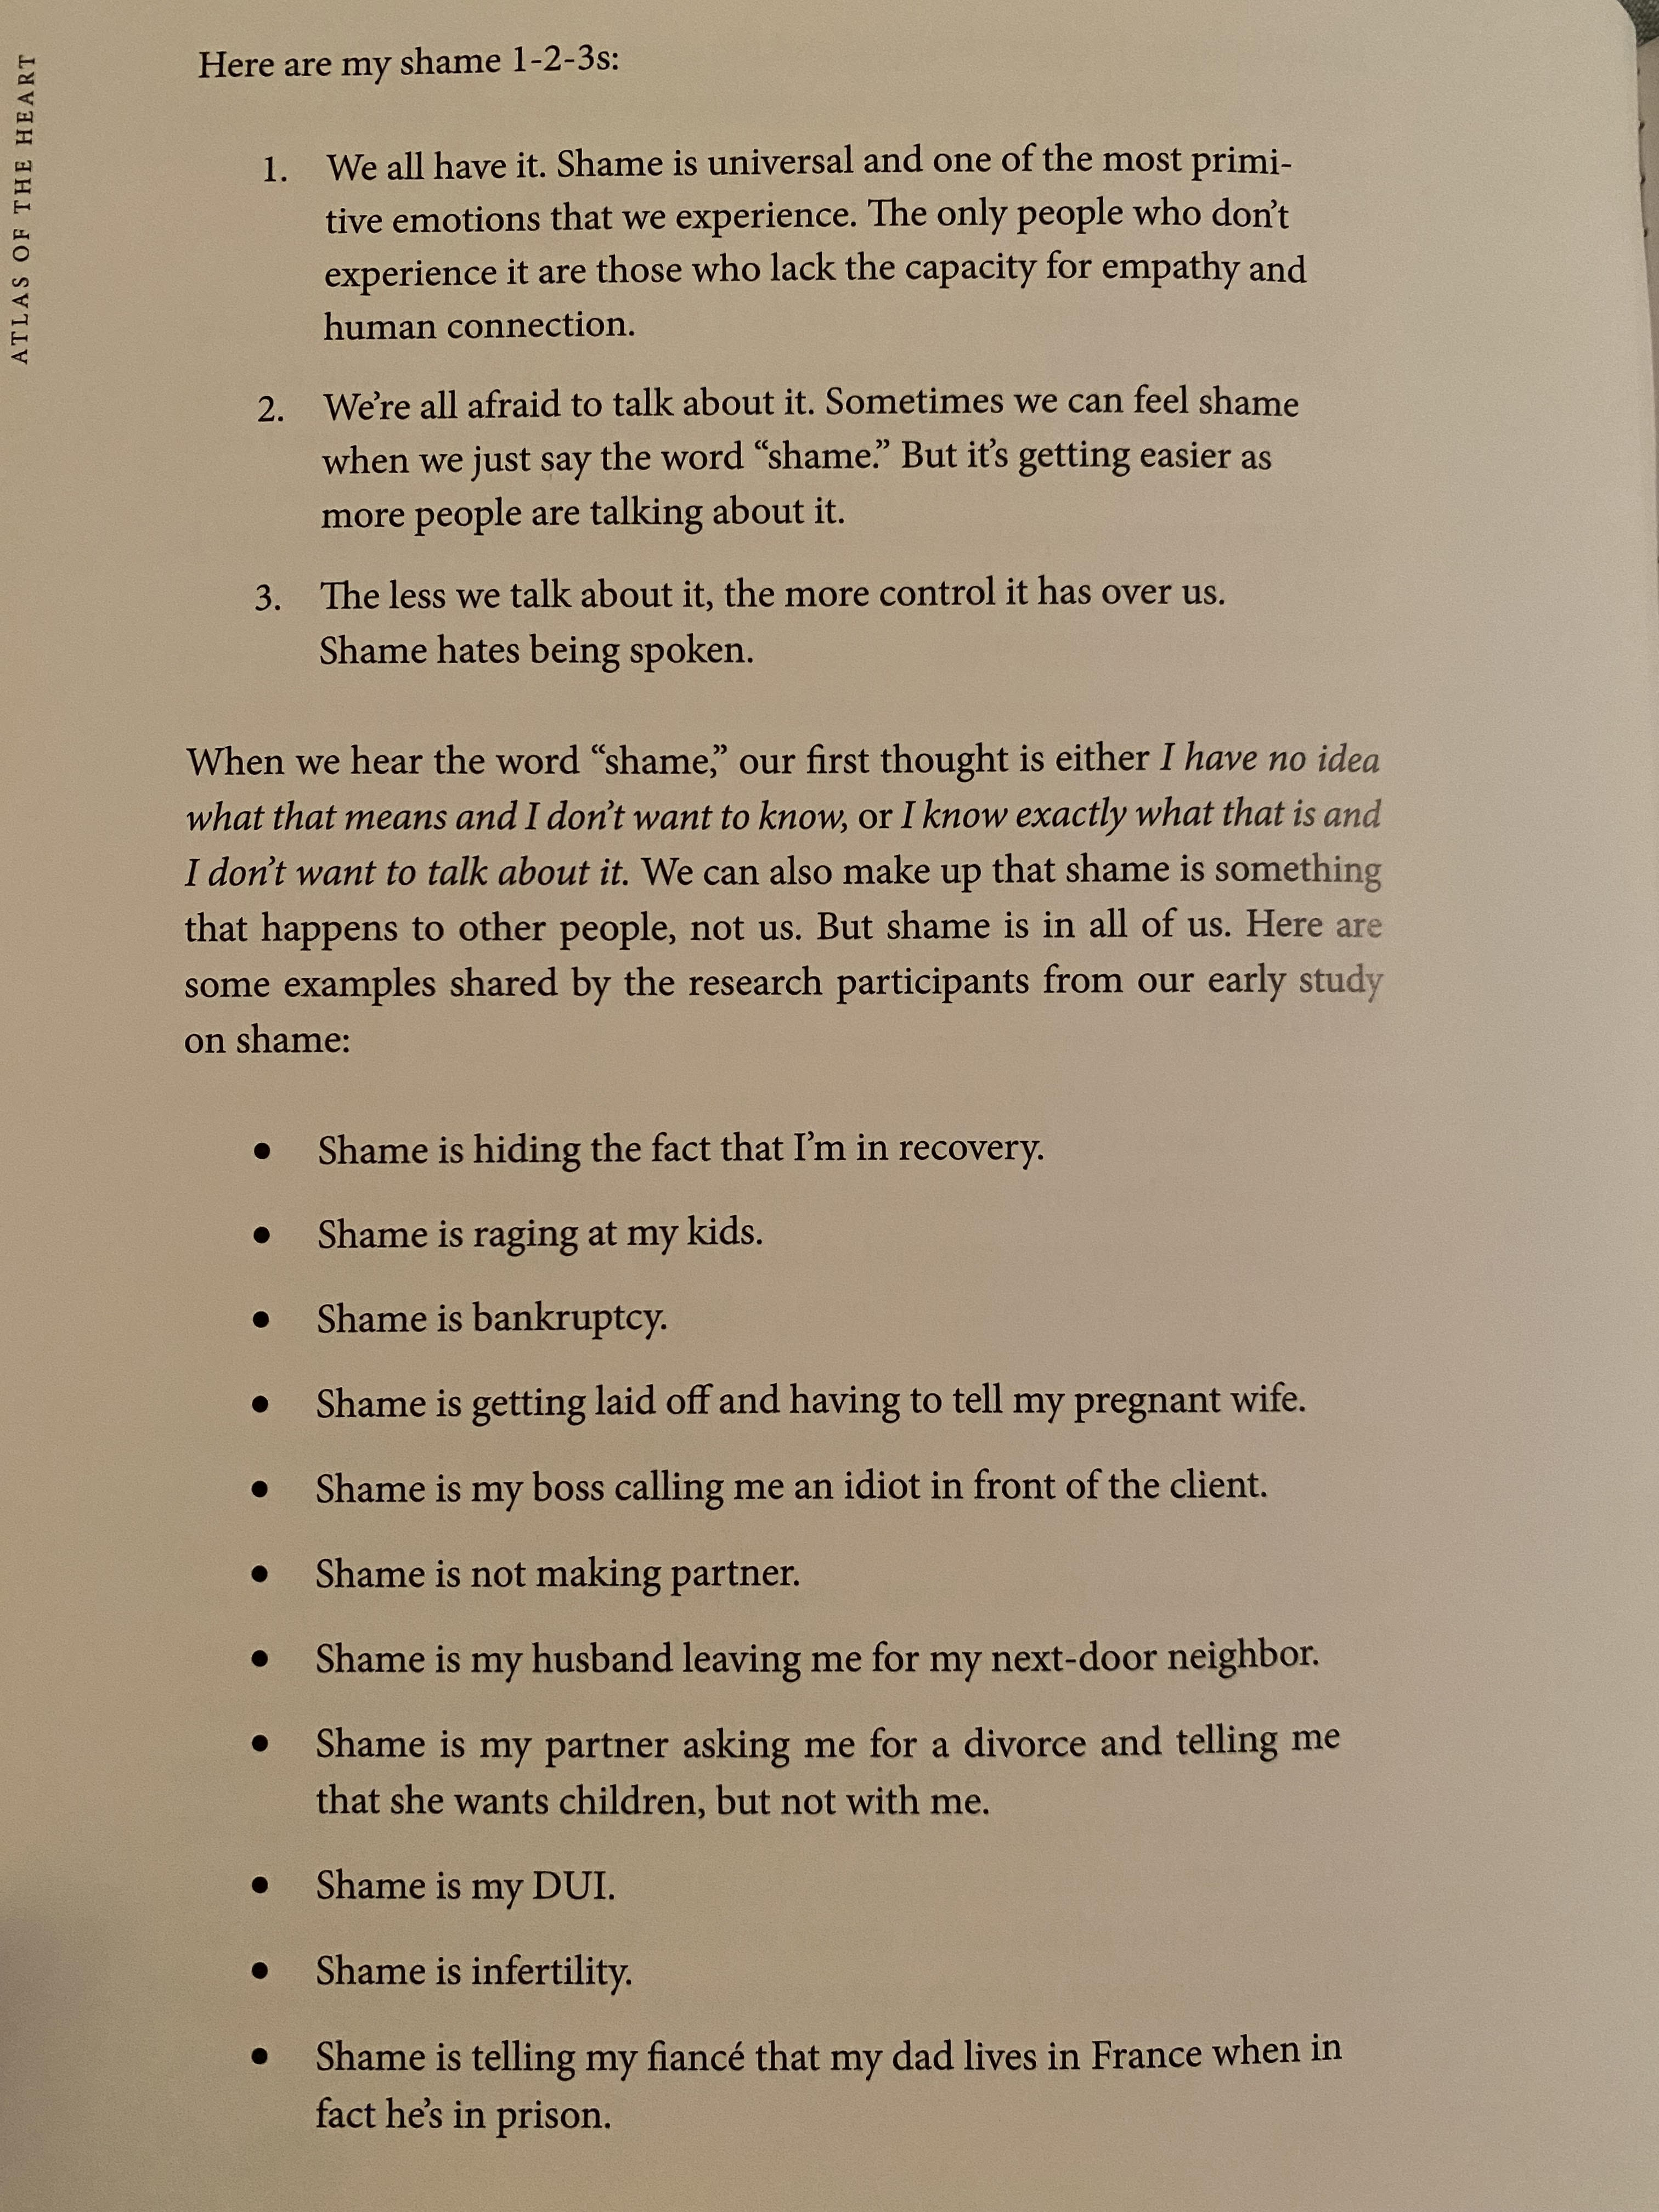
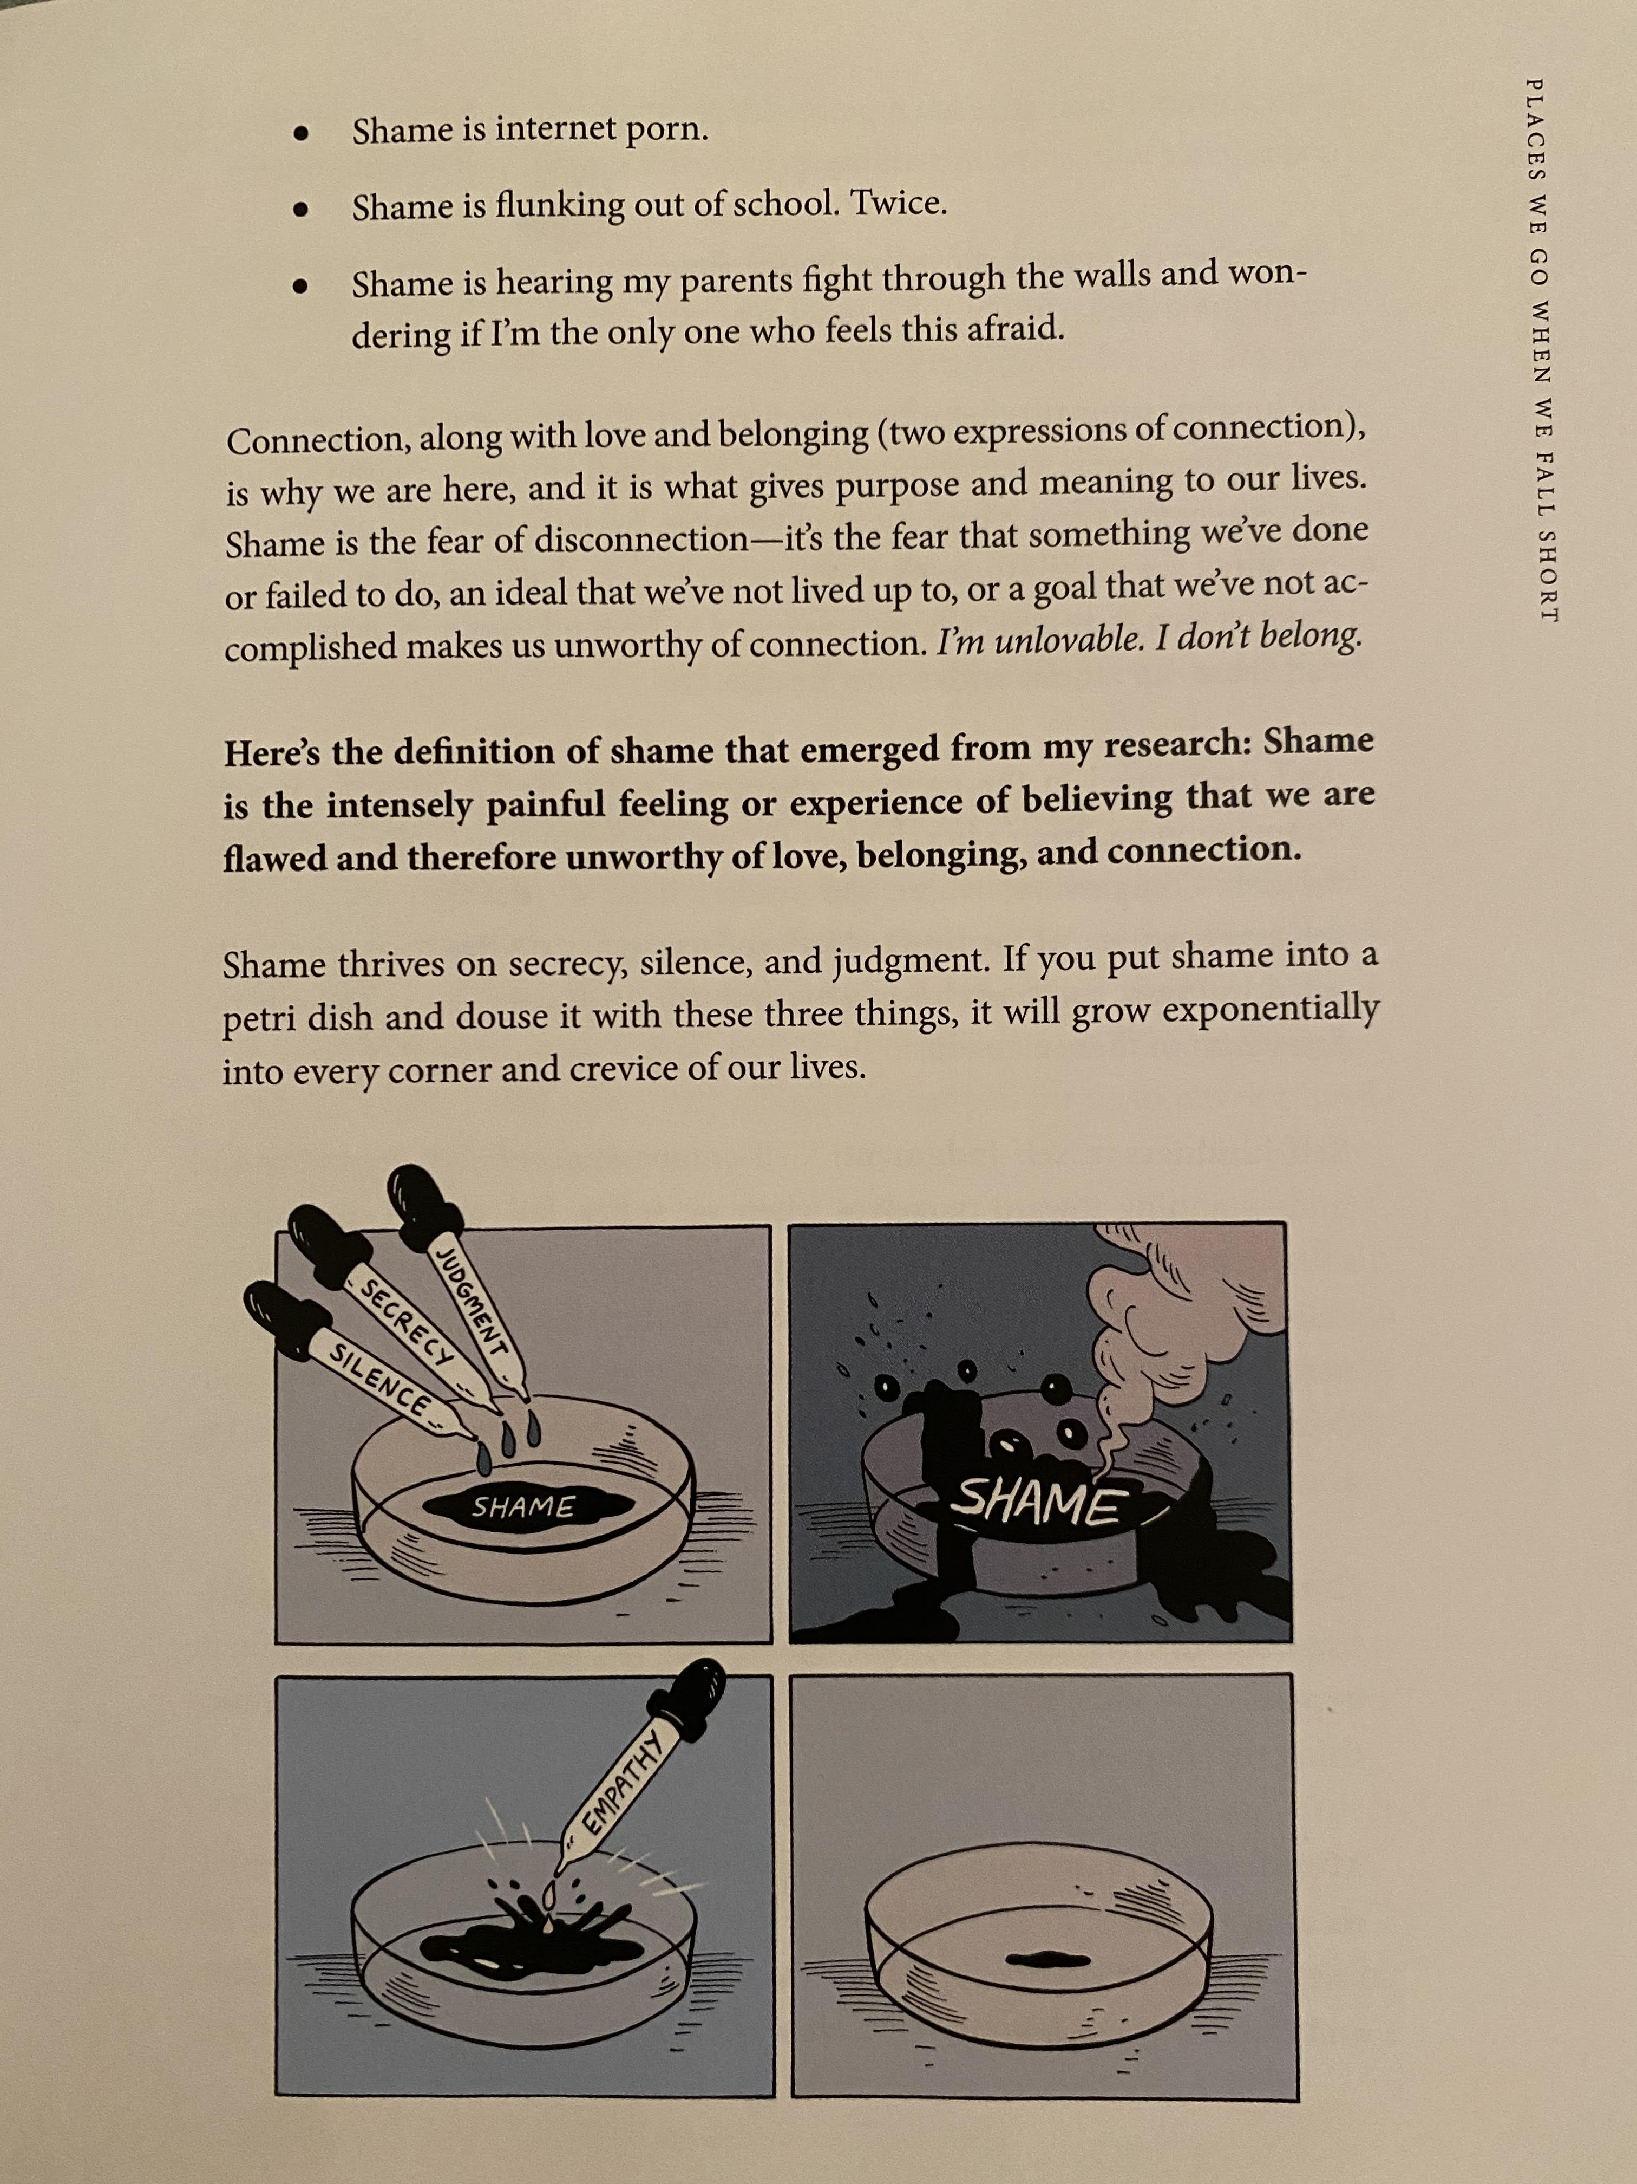
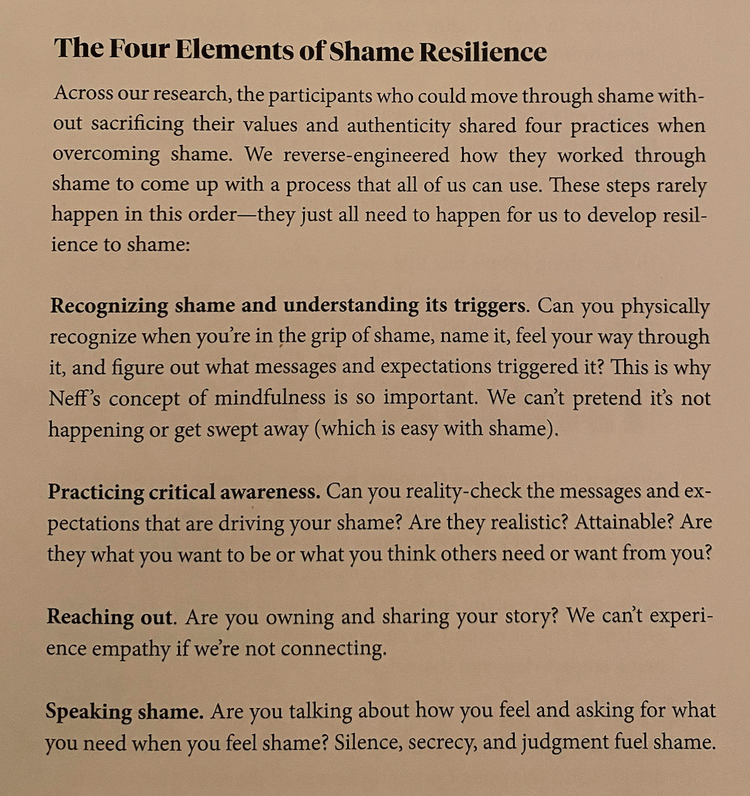
Practice Shame resilience, á la Brene Brown!
Caption
Caption
Caption

Slide 15
Practice feeling!
Moving from emotional illiteracy to Emotional Literacy
Don’t be embarrassed if you feel like you don’t know how to feel - it’s more common than you’d think!
Set an alarm on your phone that asks “how do I feel right now?”
Do this at least once a day!
Instead of saying “I AM irritated,” say “I feel irritated” or “I feel irritation moving through me.”
As you practice this more and more, it may become more granular, as in: “I feel irritation moving through me, it feels like a tightness in my chest…there is it, getting tighter and tighter, and as it tightens, I notice that I become increasingly impatient…”

Slide 16
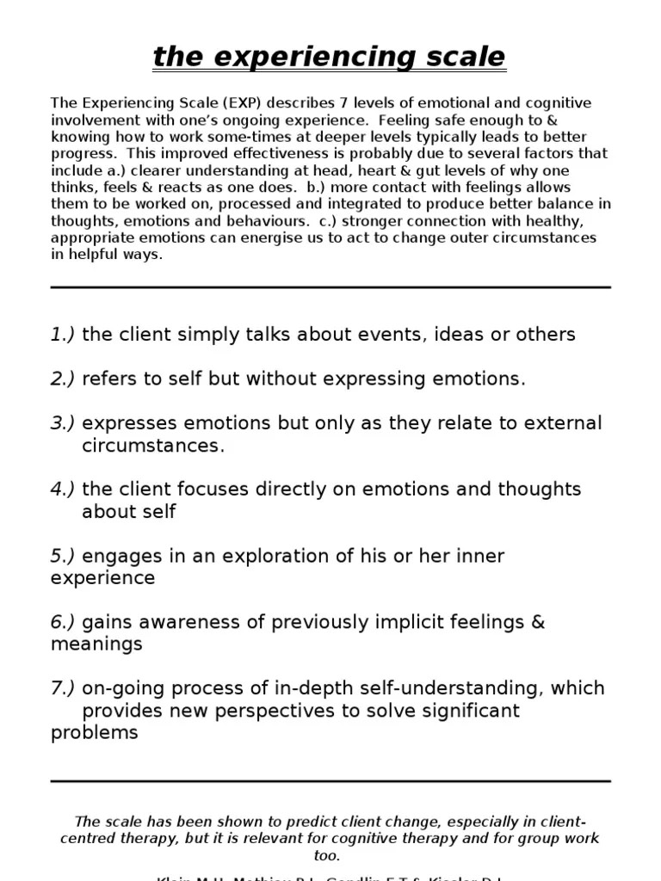

Slide 17
Learn HOW to grieve <3
Grieving is not linear, and it involves all manner of human feelings.
Being with our feelings in EMPATHY and COMPASSION - not Sympathy!!!
Brene Brown video = being with OURSELVES in this way!!
“Grief is a force of energy that cannot be controlled or predicted…Grief does not obey your plans, or your wishes. Grief will do whatever it wants to you, whenever it wants to. In that regard, Grief has a lot in common with Love.” - Elizabeth Gilbert
“The way out looks a lot like the way in” - an old mentor
Leaning on those who have seen the process of grief - other peers in a community (like ACA), a sponsor, a therapist, a guide/way-shower of some sort. Someone who can sit with you in your emotions or the protest/denial without trying to fix it and say “yes, this difficult part is a part of the journey…even if you leave, I/we’ll be here for you when you’re ready”
Reading about whatever experiences might be on your path: loneliness, addiction, dissociation, shame, fear, etc.

Slide 18
Learning about the role of RELATIONSHIPS!!
What is more important in a healing process, our relationship with ourself or our relationship with each other?
BOTH! They are inseparable. We are wounded in relationship and we heal in relationship.
We must understand the CRUCIAL difference between relationship dynamics that perpetuate stuck-ness/a lack of healing and relationship dynamics that allow us to grow and evolve as people.
co-dependency - the relationship dynamic characterized by mutual avoidance of our own needs (the laundry list!). You take care of me, I’ll take care of you, and neither of us will take care of ourselves. Result of insecure attachment.
optimal dependency - the relationship dynamic characterized by developing an honest relationship with ourselves, connecting with our feelings and our true desires, defining boundaries but knowing that it’s a process, and leaning on others. Question: are you and the other accessible, responsive, engaged, boundaried (not rigid or diffuse), and permission to be your honest self, forever evolving? Result of more-secure attachment style.
The paradox: We need to be in touch with our true/core self in order to have consistently fulfilling relationships with others, and we need to feel that we are in a safe space (relationally) in order for that core/true self to be exposed. We need BOTH!
Commentary about romantic relationship dynamics/couples counseling? Negative Cycle versus Cycle of Connection.

Slide 19
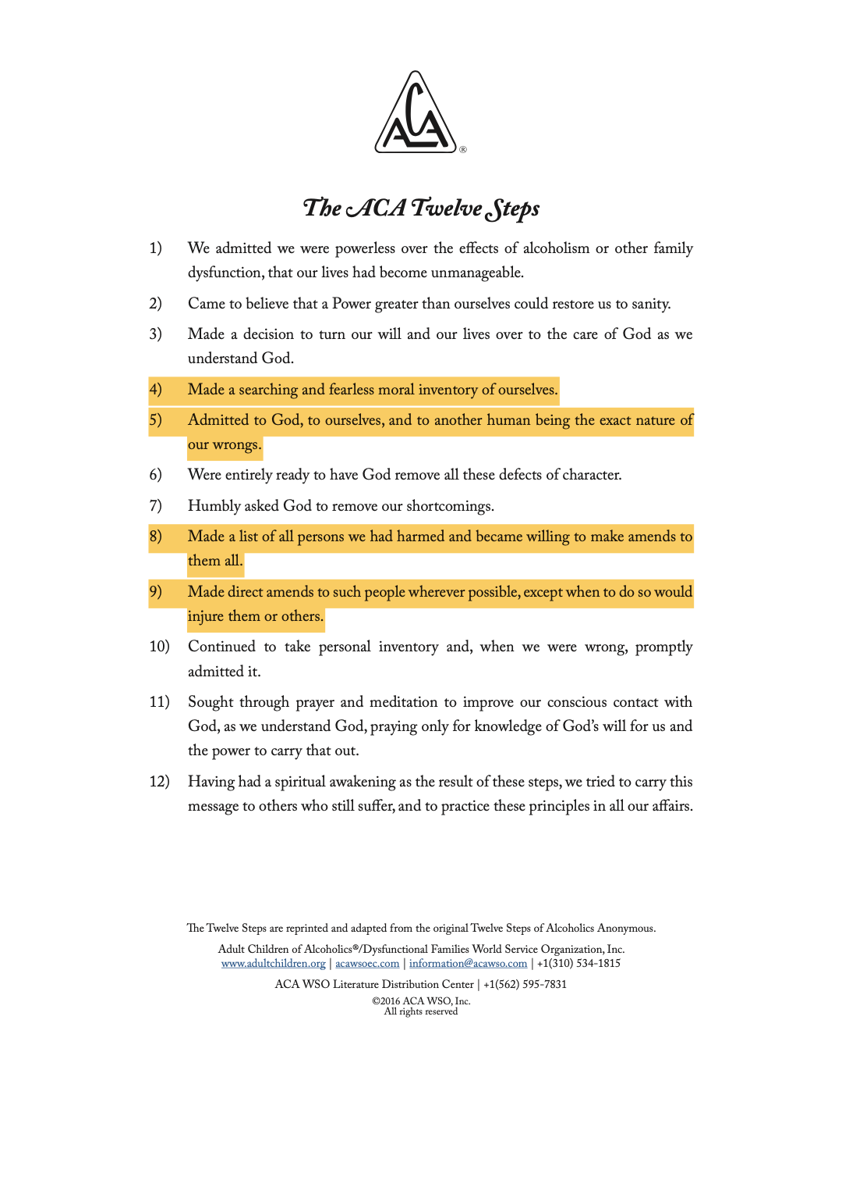
Experience self-work in COMMUNITY/ACA
Steps 4, 5, 8, 9…
Only hurt people hurt people.
The practice of being brutally honest with oneself. Have one foot in self-compassion. If you can’t access it, your sponsor & community can walk alongside you and hold it for you until you are ready. We do this for each other
This is what loving communities do <3
Caption

Slide 20
Experience Internal Family Systems Therapy (IFS)
- We are all multifaceted beings! Internally, we are literally multiple. We contain many different parts of us. This doesn’t mean we all have multiple personal disorder (or DID), but it does mean that DID is just the extreme form of very natural internal phenomena. Parts!
- In IFS, we view parts in two distinct categories. We contain Exiles, which are parts that hold our most deeply painful emotion (ie. SHAME, fear, helplessness, etc). We also contain Protectors, which can help us stave off triggers or which can help us put out the fire of emotional pain once we are already triggered (ie. Virtually any extreme-ish behavior from work to shopping to drugs to relationship dynamics).
- We all have a Self (the core of every person, our authentic self). It never goes away. It only becomes covered up by the parts, just like how clouds cover a sunny day. Cloud cover can be thick and last a lifetime!
- Our seemingly “bad” parts are not bad at all, but we need to get to know them using IFS in order to experience the truth of this for ourselves.
- The painful Exiles are often young parts of us that carry pain, which they want the SELF to fully WITNESS without trying to FIX them. They want to release their burdensome feelings, beliefs, and memories and move on. (Eg - an inner child carries shame because her teacher regularly mocked her in front of her classmates for her inability to memorize multiplication facts. She also lived in a home environment where emotions where not shared. Even though she felt loved by her parents, she couldn’t share her emotions or process the experience. They got stuck inside. Whenever this little girl, who is now and adult woman, is in a situation that reminds her in some way of a classroom, she feels flooded with shame and immediately becomes anxious. Now she needs her adult SELF to ask the anxiety to take a step back so she can connect with the young child carrying shame. She needs the SELF to hear her whole story without judgment. She wants to feel fully heard so she can move on).
- The Protectors are well intentioned parts (which tend to enact behaviors that create more pain even though that’s not their intention). They have been forced into extreme roles due to BURDENS they still carry from past traumatic/overwhelming life experiences. (Eg - a man has a harsh inner critic. He grew up learning that he should be tough and not show his emotions. His parents and culture taught him that sharing emotions makes you a untrustworthy, weak, and a sissy. Now, he is experiencing disconnection in his marriage. His partner wants to feel emotionally connected with him, but every time he thinks about sharing a feeling, a voice in his head says “you’re going to be rejected if you share that, do you want your partner to find out how weak you are? They’re going to leave you!! Fight back and criticize them for wanting more of you!” Even though this inner critic part sounds harsh, when the man gets to know this part of him from his non-judgmental SELF, he learns how valiantly this part has been trying to protect him from rejection and abandonment - feelings that he’s felt before. He learned that this part feels it is necessary to protect him in this way, but doesn’t even really like its role/job of being so harsh. Befriending this protector is just one step in the IFS healing process.)

Slide 21
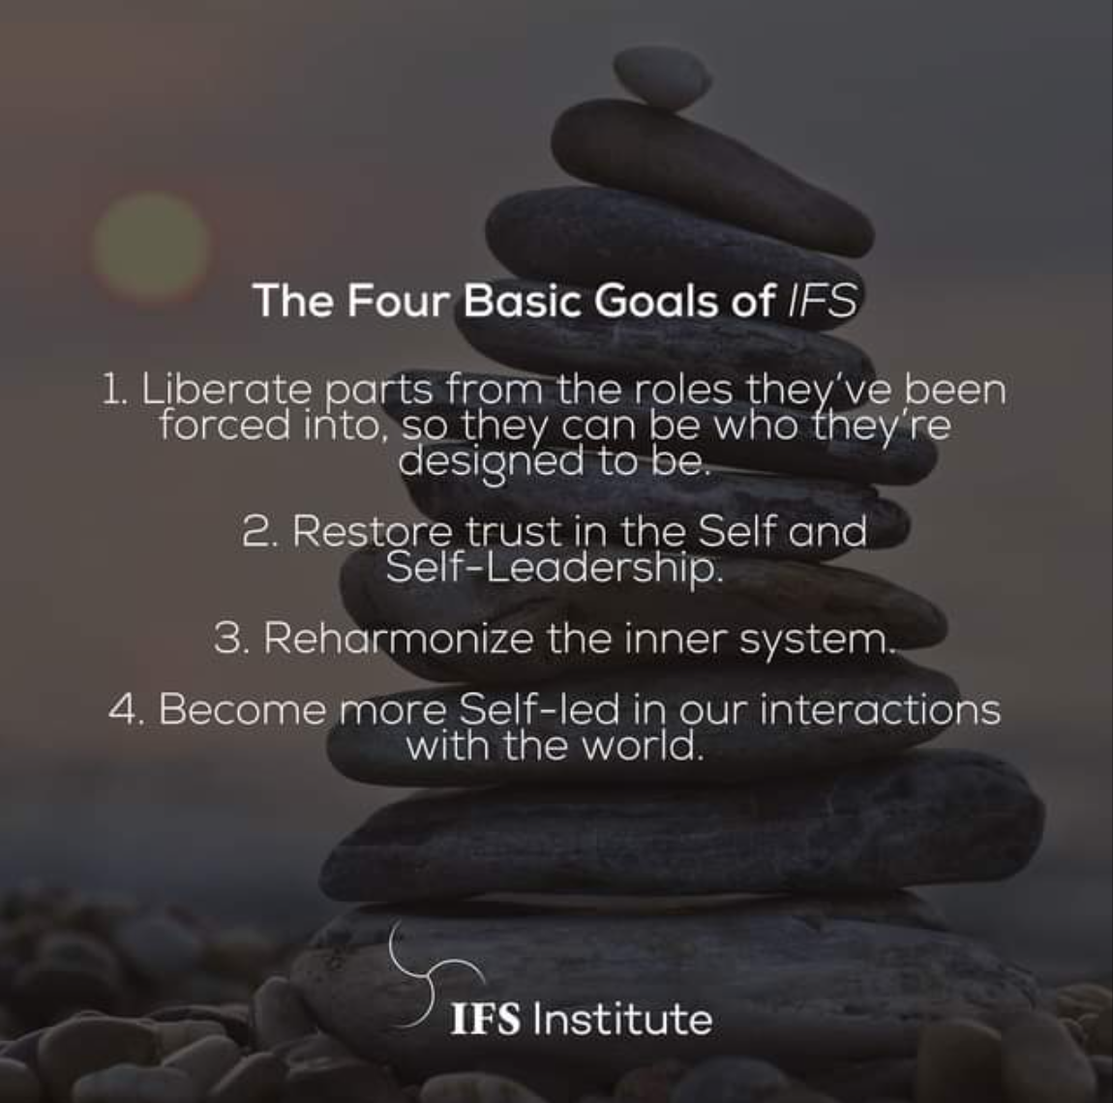
The goals of IFS
- There are many different outcomes when we meet the goals of IFS. There are external results, which are changes in behavior and relationship patterns due to internal parts shifting roles and releasing painful emotional burdens. There are internal results, which are changes in inner emotional experience.
- Increase in the “8 Cs”: Curiosity, Compassion, Clarity, Connectedness, Creativity, Courage, Confidence, and Calm.
- Increase in parts adopting balanced roles (e.g. an inner critic no longer bashes someone or calls them names, now it offers critique in key moments when the Self requests its thoughtful feedback. It now works to support the person. It can offer critique in a compassionate and growth-oriented encouraging manner. This shift reduces anxiety and depression).
- IFS is evidenced-based practice used to treat a range of MHD, including anxiety, depression, PTSD, substance abuse and eating disorders.

Slide 22
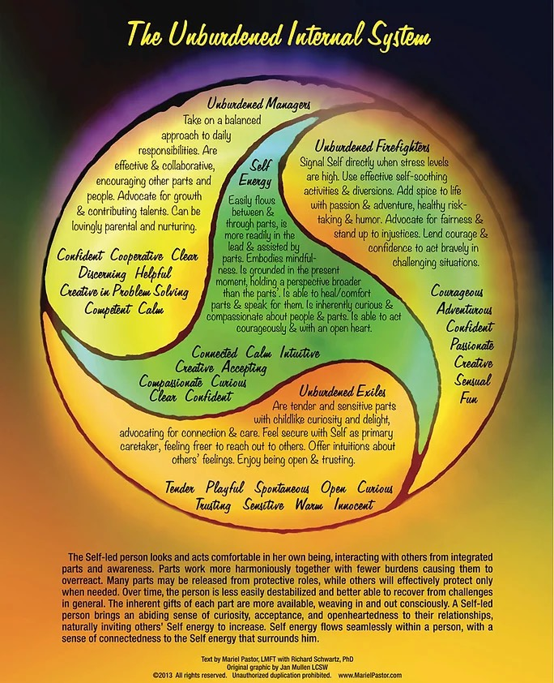
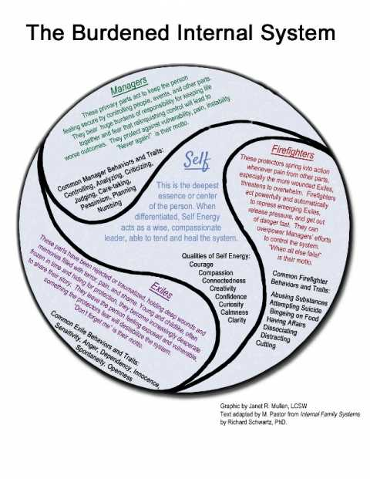

Slide 23
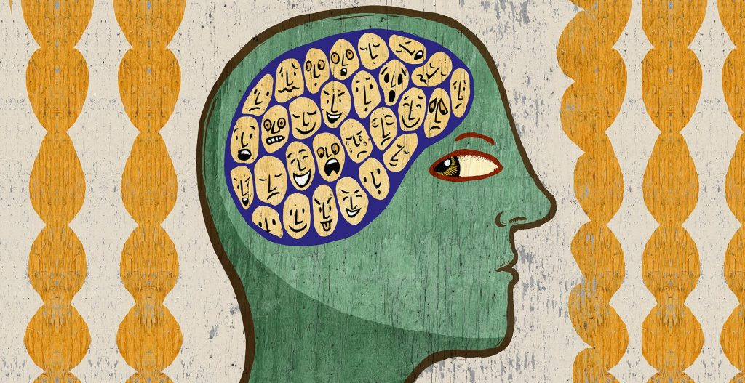
Exercise

Slide 24
Questions?
For questions that may come up later. Our contact information:
Katie - theveka@gmail.com
Marcio - gentlefloat@gmail.com

Slide 25
Thank you so much for having us!!!
(be willing, be honest with yourself, surrender when the time comes, lean on safe people, and trust in your resilience)

